Slide 1

Analysis of the Effects of Regulation on Railroad Safety
Kai Liao, Katrina Siegfried, Andrew smith – Group 17

Slide 2
Project Description
Accidents at highway-railroad intersections cause tremendous losses of lives and resources. This project aims to consider the impacts of new regulations, locations of intersections, and the characteristics/topography of intersections to determine which features promote safety and which features do not.
Effects of Positive Train Control (PTC) Regulation
Accident Analysis by Location
Effects of Intersection Characteristics

Slide 3
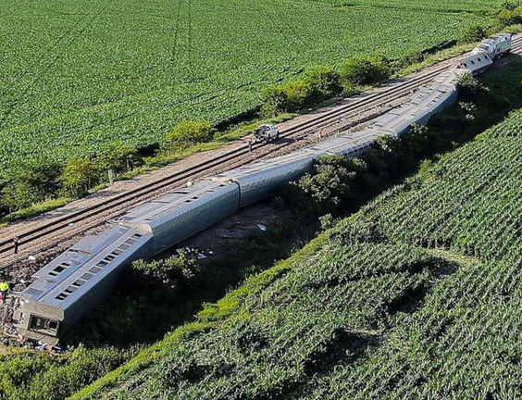
June 27, 2022: An Amtrak passenger train struck a dump truck in rural Missouri crossing a passive intersection with no crossing bars, lights and bells. Several trains and locomotives derailed, 150 people were injured, and 4 killed. Cost of implementing active restraints would have been $400,000. There are 130,000 passive railroad crossings nationwide.
Project Relevance
© Tribune News Service via Getty Images

Slide 4
Prior Work
Paper | Author | Work Performed | Data Set | Tools | Methods
Analysis of Causes of Major Train Derailment and Their Effect on Accident Rates | Liu et al. (2012) | Identify the causes of train accidents and their effect on accidents rates | Transportation railroads FRA U.S gov. data , (2001–2010 dataset) | Weka tool | Chi-square analysis
Text Mining the Contributors to Rail Accidents | Brown et al. (2016) | Discussed severity of road accident survey. | FRA dataset, from 2001 to 2012 | Weka tool | text mining techniques, random forests, partial least squares, latent Dirichlet allocation
Bala, Manju & Bhasin, Anshu. (2018). A Review on Analysis of Railway Traffic Accident with Data Mining Techniques. International Journal of Computer Sciences and Engineering. 6. 1251-1256. 10.26438/ijcse/v6i6.12511256.

Slide 5
Prior Work (cont.)
Paper | Author | Work Performed | Data Set | Tools | Methods
Identifying vehicle driver injury severity factors at highway-railway grade crossings using data mining algorithms | Ghomi et al. (2017) | Identify injury of drivers in factors of highway-railway grade crossing. | U.S (FRA) accident dataset the period of 2006–2013 | STATA13 software package tool | Chi-square analysis
Analyzing the Train Accident Injuries using Mining Techniques | Nireesa et al. (2017) | Describe techniques to identify characteristics of accident. | 11 years 2001 to 2012 rail accidents U.S. Data set | Weka tool | Association rules, Apriori algorithm
Bala, Manju & Bhasin, Anshu. (2018). A Review on Analysis of Railway Traffic Accident with Data Mining Techniques. International Journal of Computer Sciences and Engineering. 6. 1251-1256. 10.26438/ijcse/v6i6.12511256.

Slide 6
Prior Work (cont.)
Paper | Author | Work Performed | Data Set | Tools | Methods
Human and Organizational Factors of Positive Train Control Safety System | Khashe et al. (2019) | Examining PTC implementation success using organizational safety method | U.S (FRA) accident dataset the period of 1996–2015 | General statistical methods | High Reliability Organizing (HRO)
A Novel Data Mining Approach for Analysis of Accident Paths and Performance Assessment of Risk Control Systems | Singh et al. (2020) | Analyze accident paths from incident data and assess performance | Occupational accidents in a steel manufacturing plant in India | Python | Temporal- frequent-, elevated-severity-, and high-impact itemset generation

Slide 7
Dataset
US Department of Transportation – Federal Railroad Administration – Office of Railroad Safety
Highway-Rail Crossing Database
186 Attributes
436,498 Entries
42,567,011 non-empty entries
Collection of all Reports from all US Highway-Rail incidents between 1970-May 2022
https://safetydata.fra.dot.gov/OfficeofSafety/publicsite/DownloadCrossingInventoryData.aspx
All members have the data downloaded

Slide 8
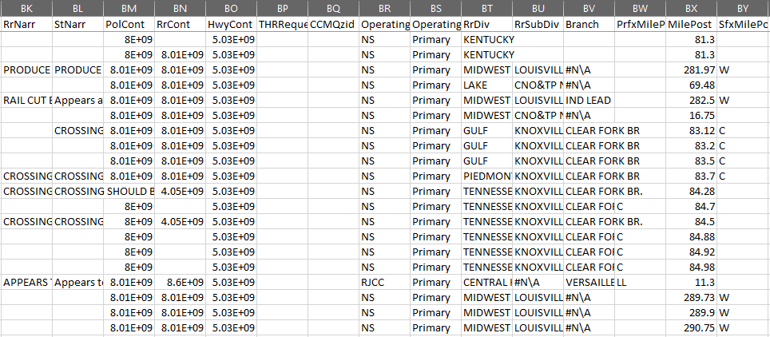
Proposed Work
Data Cleaning:
Correct spelling in narratives, make all letters capital.
Ensure all attributes don’t have duplicate items representing the same thing
Address missing values for each attribute

Slide 9
Proposed Work (cont.)
Data Preprocessing:
PTC implementation:
Data reduction using domain “expert” selections.
Data transformation by selectively smoothing, normalizing, discretizing data as needed; concept hierarchy generation to mine at different abstraction values; vertical format for FP-growth; one-hot encoding.
Crossing Location:
Fill in blanks with identical placeholders or inferred data (if possible).
Verify identical formatting for all nominal values and choose relevant orders for ordinal values.
Crossing Characteristics:
Specify crossing characteristic attributes as necessary attributes to compare to.
Remove irrelevant administrative and reserved attributes.

Slide 10
Tools to Use
Tools:
Python toolboxes
pandas: data cleaning
numpy: data transformation
sklearn: fix encoding if needed (one-hot), test-train split, random forest
pyspark: fp-growth
Methods:
Decision Trees
FP-Growth
Notes:
Anyone

Slide 11
Evaluation
Method | Details | Evaluation
Decision Tree | Random Forest RI with bagging, will also help with attribute selection, use to generate if-then rule based model | 80-20 train/test split, sampling without replacement; accuracy, sensitivity, precision, specificity, F1, Fb
FP-Growth | Explore vertical format to expedite itemset generation; rule pruning | Support, lift, confidence, Χ2, Kulczynski measure, cosine; final selection of measure dependent on performance on data
Notes:
Katrina

